Slide 1


Lead-Acid Battery Charger
Gajaanan S. -190185D
Pankajan T. -190428D
luXshan S. -190364C
Mokeeshan V.-190395V

Slide 2
Overview
Introduction
Circuit Explanation
Project timeline
Progress
References

Slide 3
Battery charging…
Introduction
Progress
Circuit
Timeline
References
Specifications-
230V AC to 30V DC converter and regulator
8A current
CCCV method

Slide 4

Functional Block Diagram
Introduction
Progress
Circuit
Timeline
References
230V AC Source
Obtain30V DC Voltage
Generate Triangular waveform
PWM Waveform Generation
Smoothing Circuit
24V, 8A Lead Acid Battery
Switching Circuit
Adjust PWM based on current(A) reading.
Yes
Constant current mode
V<V_{ref}(28.8V)
No
Constant voltage mode
Adjust PWM based on voltage across battery.

Slide 5
Introduction
Progress
Circuit
Timeline
References
1st Week
Finalize circuit and Components
2nd Week
Start to build Circuit physically
4th Week
Print PCB and finish
Finalize physical circuit
3rd Week

Slide 6
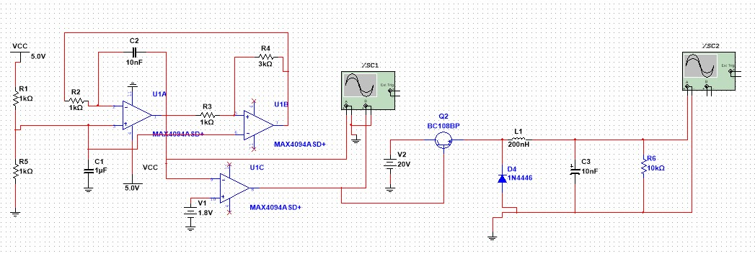
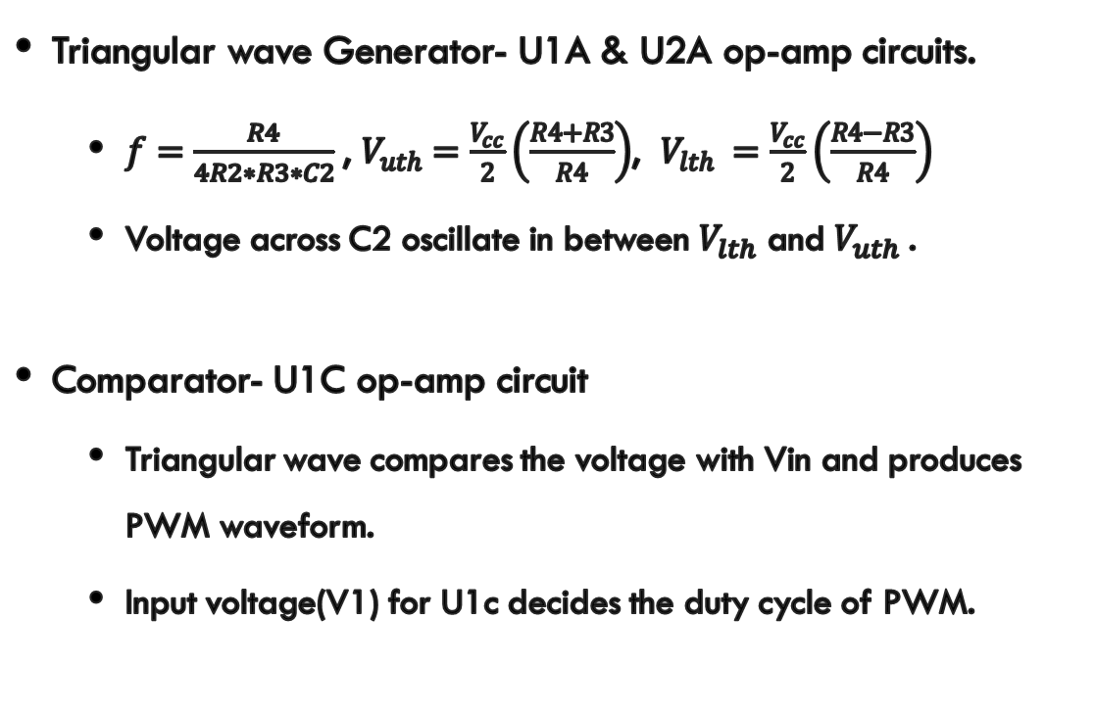
PWM generation-Method 1
Introduction
Progress
Circuit
Timeline
References
Triangular wave Generator- U1A & U2A op-amp circuits.
$f=\frac{R4}{4R2∗R3∗C2}$, $V_{uth}=\frac{V_{cc}}{2}\left(\frac{R4+R3}{R4}\right)$, $V_{lth} =\frac{V_{cc}}{2}\left(\frac{R4−R3}{R4}\right)$
Voltage across C2 oscillate in between $V_{lth}$ and $V_{uth}$.
Comparator- U1C op-amp circuit
Triangular wave compares the voltage with Vin and produces PWM waveform.
Input voltage(V1) for U1c decides the duty cycle of PWM.

Slide 7
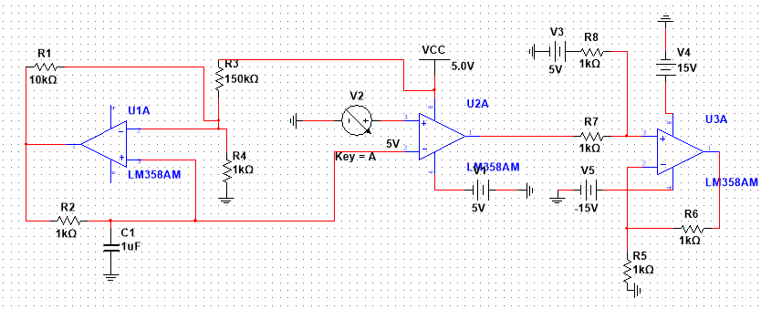
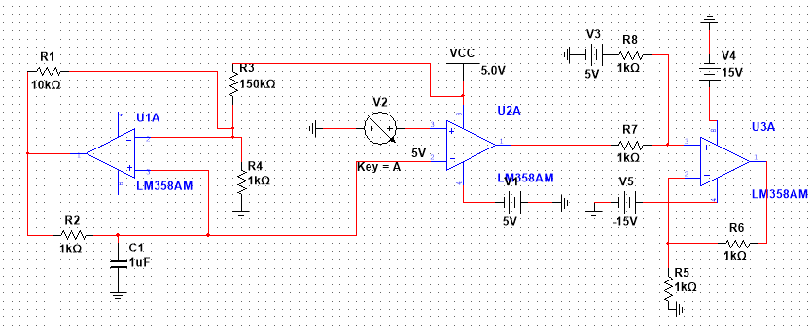
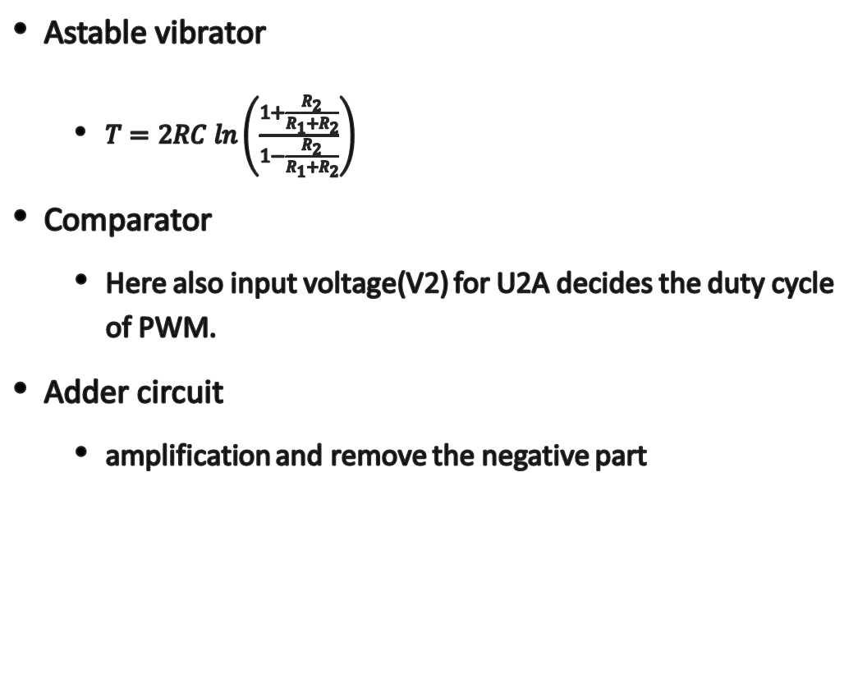
PWM generation-Method 2
Introduction
Progress
Circuit
Timeline
References
Astable vibrator
$T=2RC ln\left(\frac{1+\frac{R_{2}}{R_{1}+R_{2}}}{1−\frac{R_{2}}{R_{1}+R_{2}}}\right)$
Comparator
Here also input voltage(V2) for U2A decides the duty cycle of PWM.
Adder circuit
amplification and remove the negative part

Slide 8
Smoothing Circuit
Introduction
Progress
Circuit
Timeline
References
Buck converter had been selected to smooth the PWM waveform and to convert voltage(DC to DC)
Change the output regarding the duty cycle of PWM.

Slide 9
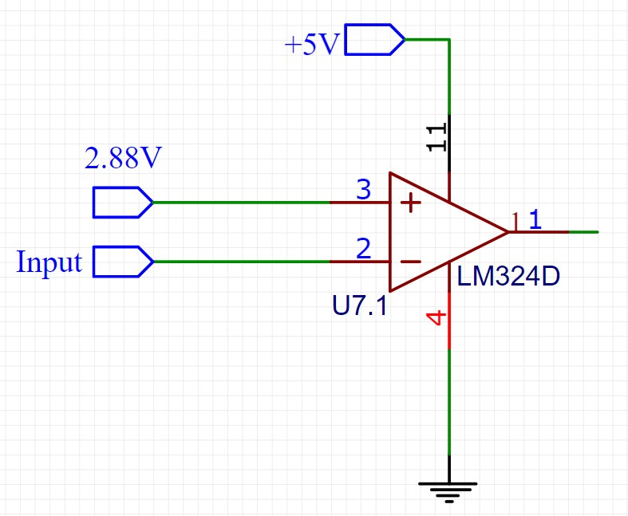
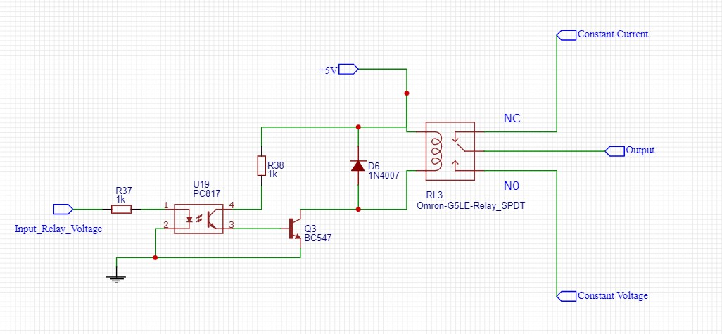
Switching-Method 1
Introduction
Progress
Circuit
Timeline
References
1) Comparator
If Battery voltage < 28.8 V, Comparator will produce 0V.
If Battery voltage > 28.8 V, Comparator will produce 5V.
2) 5V relay
If Comparator output voltage = 0V ,
Initially, the relay will connect a constant current mode connection.
If Comparator output voltage = 5V ,
The relay will connect a constant voltage mode connection.

Slide 10
Switching-Method 2
Introduction
Progress
Circuit
Timeline
References
Using Power MOSFETs to control the constant current and constant voltage part.
If Battery voltage > 28.8 V,
Comparator will produce 10V. So, Inially, N-MOSFET will connect constant current mode connection.
If Battery voltage < 28.8 V,
Comparator will produce -10V. So, P-MOSFET will connect constant current mode connection

Slide 11
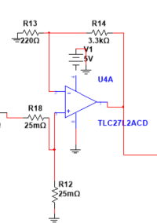
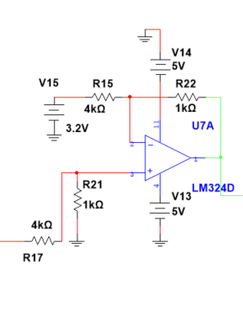
Constant Current Control
Introduction
Progress
Circuit
Timeline
References
Approach:
Measure the current
find out the error
manipulate the PWM signal
Low-side current sensing for current measurement
We chose low-side current measurement for a cost-effective solution and easy implementation.
This low-side current sensing has an operational amplifier in a non-inverting configuration.
Differential amplifier circuit for error measurement
A differential amplifier is used to measure error.
Stationary voltage previously calculated should be applied since it corresponds to 8A

Slide 12
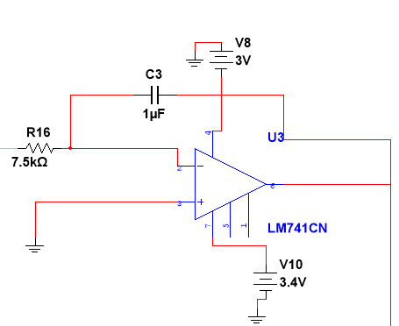
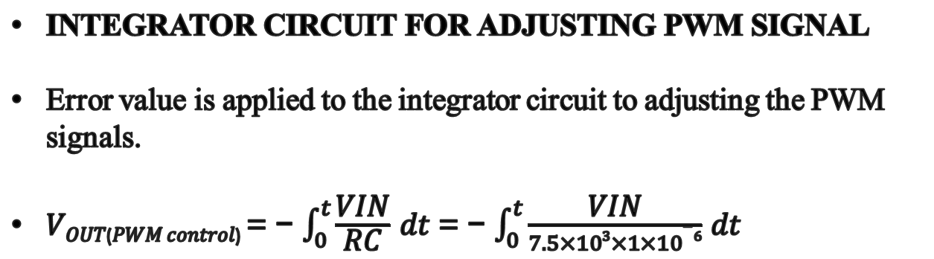
Introduction
Progress
Circuit
Timeline
References
INTEGRATOR CIRCUIT FOR ADJUSTING PWM SIGNAL
Error value is applied to the integrator circuit to adjusting the PWM signals.
𝑉_{𝑂𝑈𝑇(𝑃𝑊𝑀 𝑐𝑜𝑛𝑡𝑟𝑜𝑙)} = − $\int_{0}^{t}{\frac{\text{VIN}}{\text{RC}}}$ 𝑑𝑡 = − $\int_{0}^{t}{\frac{\text{VIN}}{7.5×103×1×10−6}}$ 𝑑𝑡
If 8A > I_{LOAD} ,
V_{out} maintains increasing until the correct voltage is wanted for the PWM duty cycle.
If 8A < I_{LOAD} ,
V_{out} maintains decreasing until the correct voltage is wanted for the PWM duty cycle.

Slide 13
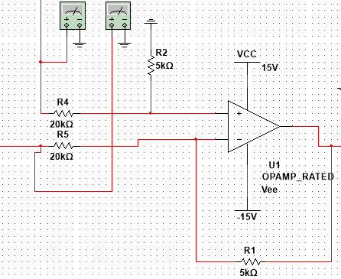
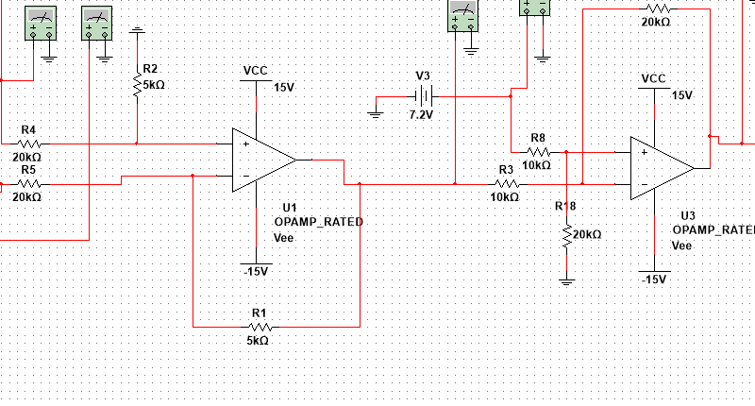
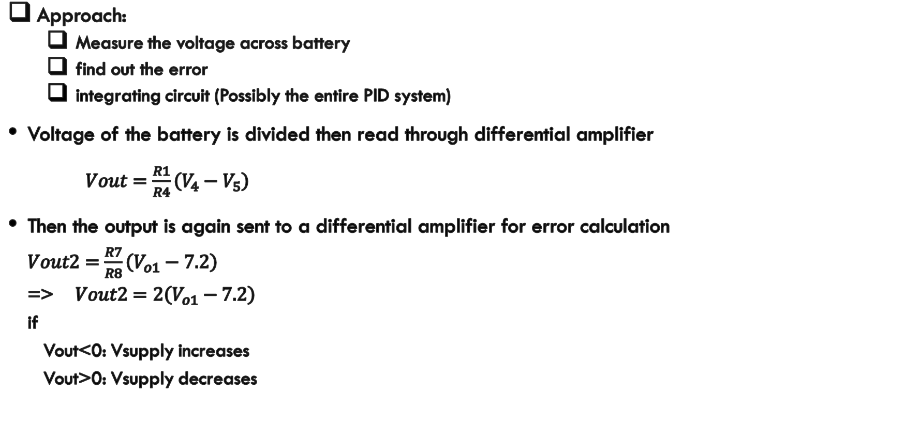
Constant Voltage Control
Introduction
Progress
Circuit
Timeline
References
Approach:
Measure the voltage across battery
find out the error
integrating circuit (Possibly the entire PID system)
Voltage of the battery is divided then read through differential amplifier
$Vout=\frac{R1}{R4}\left(V_{4}−V_{5}\right)$
Then the output is again sent to a differential amplifier for error calculation $Vout2=\frac{R7}{R8}\left(V_{o1}−7.2\right)$ => $Vout2=2\left(V_{o1}−7.2\right)$ if Vout<0: Vsupply increases Vout>0: Vsupply decreases

Slide 14
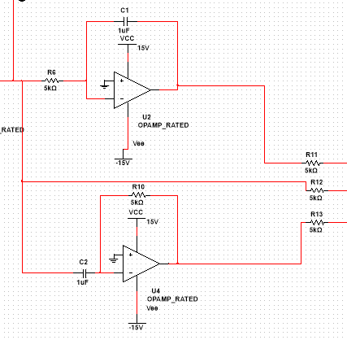
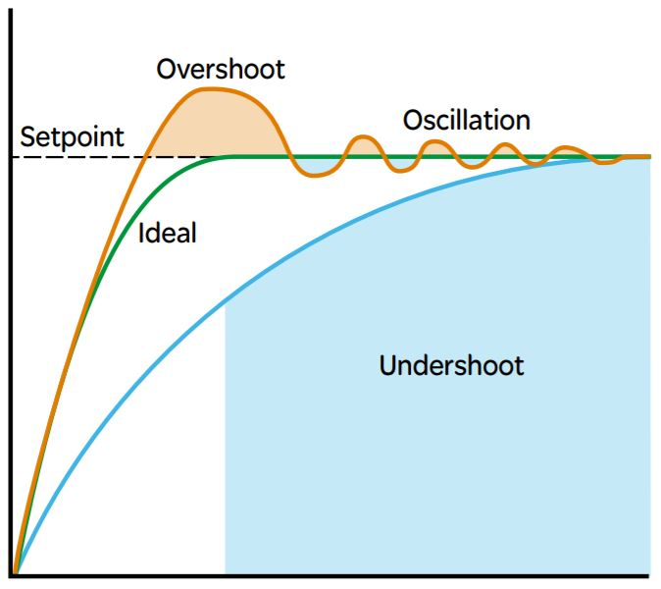
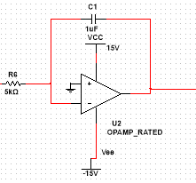
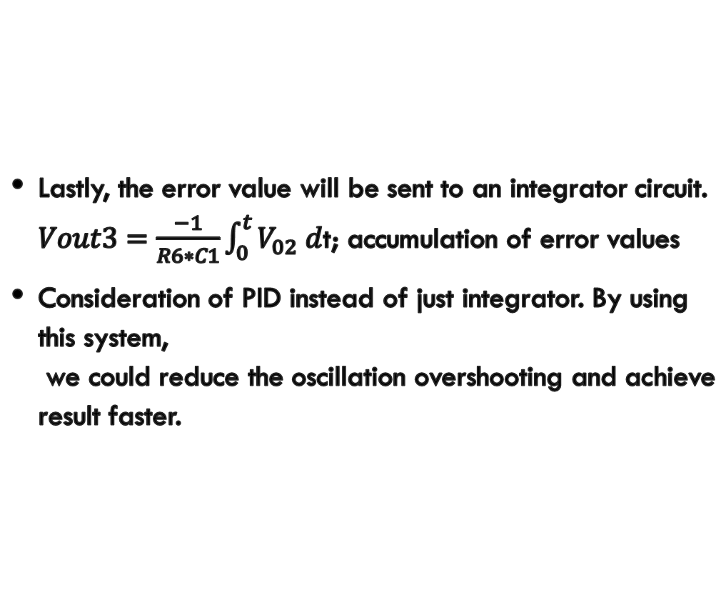
Introduction
Progress
Circuit
Timeline
References
Lastly, the error value will be sent to an integrator circuit. $Vout3=\frac{−1}{R6∗C1}\int_{0}^{t}{V_{02} d}$t; accumulation of error values
Consideration of PID instead of just integrator. By using this system, we could reduce the oscillation overshooting and achieve result faster.

Slide 15
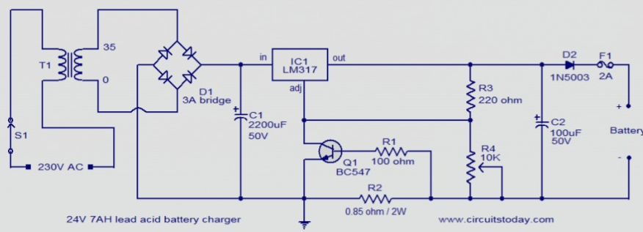
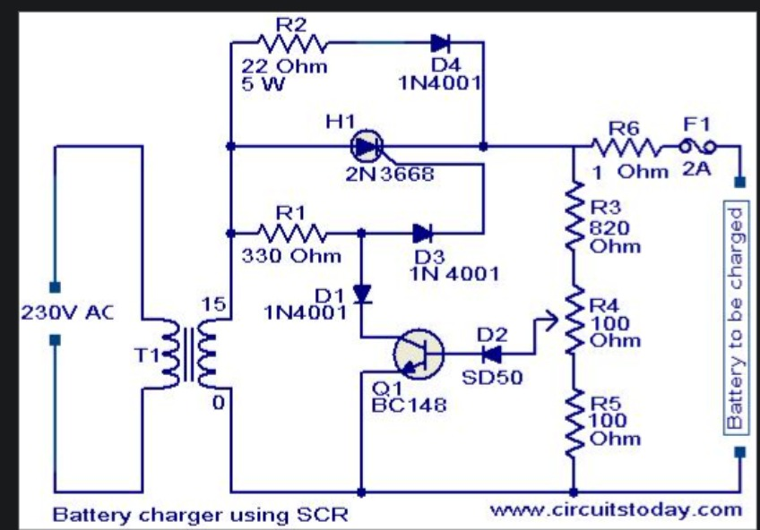
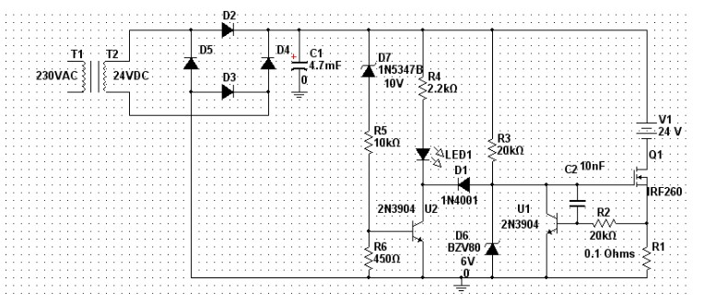
Some other circuit findings
Introduction
Progress
Circuit
Timeline
References

Slide 16
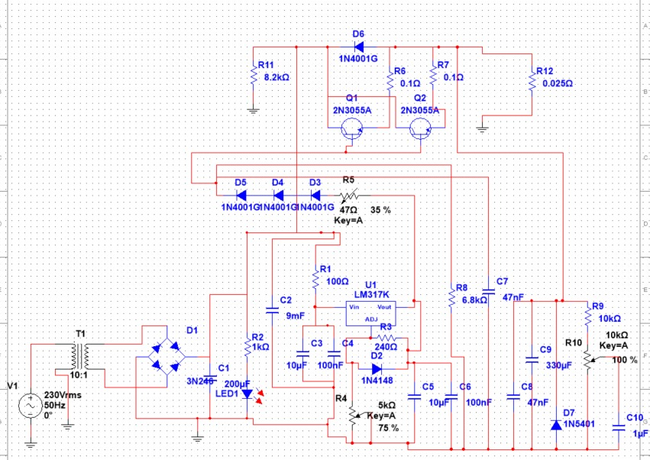
AC-DC converter
Introduction
Progress
Circuit
Timeline
References

Slide 17
Up to now….
Introduction
Progress
Circuit
Timeline
References
Find various battery charging methods and theories behind circuits.
Finished calculations for PWM based circuit
Have working simulations for PWM.
Build the basic physical circuit on breadboard for PWM,CC and CV

Slide 18
Introduction
Progress
Circuit
Timeline
References
https://www.ti.com/lit/an/sboa169b/sboa169b.pdf?ts=1647110122143
https://eeebooks4u.com/2021/05/29/astable-multivibrator-using-op-amp/
https://batteryuniversity.com/article/bu-403%20charging-lead-acid
https://www.hilarispublisher.com/open-access/charging-leadacid-batteries.pdf
https://www.engineeringenotes.com/electrical-engineering/batteries/charging-of-lead-acid-battery-methods-and-precaution-electricity/29991

Slide 19
Thank you

